Slide 1

CS 5439: Clinical computer security
Tom Ristenpart

Slide 2
Four categories of common attacks
Ownership-based
Account/device compromise
Abuser owns device/account
Shared account/device
Buying children device
Prevent use / destroy device
Digitally control access
Track location, monitor usage
Physical access to unlocked device
Force password / pin revelation
Remotely “hack” via security questions / passwords
Install spyware / “dual-use” app
Track location, monitor victim
Steal or delete info
Lock victim out of account
Impersonate victim
Harmful messages or posts
Exposure of private information
Call/text/message victim (from spoofed account)
Post harmful content (e.g., threaten violence)
Harass victim’s friends/family
Proxy harassment
Blackmail by threat of exposure
“Doxxing” victim
Non-consensual intimate images
Fake profiles/advertisements of sexual services

Slide 3
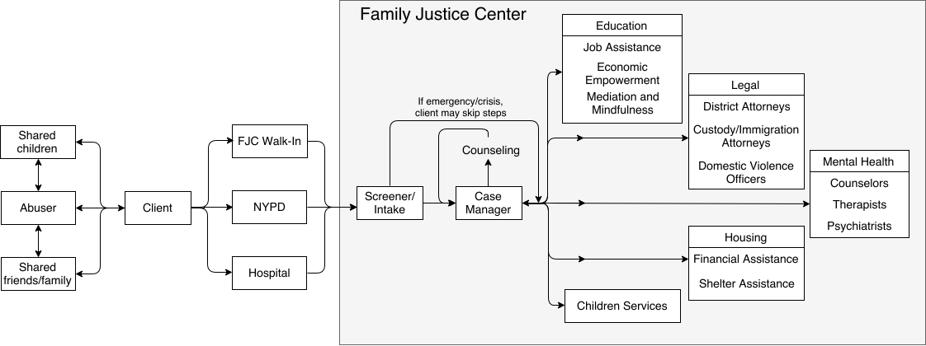
Clinical services for IPV victims

Slide 4
Clinical computer security
Technology volunteers (or professioinals) assisting clients with security issues via:
Face-to-face consultation
Technology investigations
How to recruit, screen, & train volunteers?
How to handle referrals and hand-off?
What tools are needed to perform investigations?
What legal protections are needed?
How do we evaluate outcomes?
How should consultations work?
This is work in-progress. What I’ll discuss has not been validated yet!

Slide 5
Clinical models
Clinical models describe how to manage a clinic and deliver service
Clinic model should include philosophy driving design
Client-centered approach (aka survivor-defined practice)
Client’s well-being and safety paramount
Technical tools must be used with appropriate care!
“At Safe Horizon, we believe that our clients are the experts in their own lives. We offer support, information, and expertise so that each client can exercise his/her right to make informed decisions and choose their own path. This survivor-defined practice is characterized by an emphasis on client choice, collaboration, and a sensitivity to the unique needs, risks, and resources of each individual.”
https://www.safehorizon.org/programs/preliminary-results-of-the-client-centered-practice-evaluation/

Slide 6
Clinical models
Clinical models describe how to manage a clinic and deliver service
Technology assistance
Bootstrap off existing infrastructure
Partner with existing non-profit or government organizations
TECC clinic example

Slide 7
Referrals, hand-off, and managing roles
Part of clinical model is how clients end up being seen:
Referral-based treatment: Case manager or other professional refers client for a technology consultation
Walk-in treatment: Client can walk in to get technology consultation
Mixture
Hand-off is process of passing responsibility for helping client between professionals:
Safety planning must take into account more than just technology situation
Technology expert may not have information or be sufficiently trained to do safety planning
Legal counsel may want evidence discovered by tech volunteer

Slide 8
Goals of tech consultation
Overarching:
Provide information and support for client’s technology issues
Identify unrecognized technology issues
Identify chief concerns
Ascertain client’s tech footprint and history
Diagnose threats
Provide information on remediations

Slide 9
Proposed consultation structure
Pre-consultation with referring advocate
Introductory safety procedures
Discussion
Investigation
Wrap-up
Follow-up

Slide 10
Pre-consult and safety procedures
Pre-consult:
Overview consultation for case manager (or other professional)
Mention safety planning handoff
(Optionally) Gather some information on client
Requires client consent
Safety procedures:
Devices may pose immediate risk to those in room, i.e., if they have spyware installed
Currently planning on using faraday bags during initial discussion

Slide 11
Discussion phase
Discuss with client their technology concerns
Map technology footprint (what devices? What accounts?)
Identify entanglements (e.g., children’s devices)
Get a rough timeline (when was an account accessible to abuser?)
Try to identify chief concerns
Try to identify other potential risk factors
Can use instrument like TAQ-10
(Technology Assessment Questionnaire)

Slide 12
An example case
Carol has been suffering abuse for several years from her now ex-husband. After a few years of escalating sexual, emotional, and physical abuse, she recently left him and now lives in her own apartment with their 10 year old child. Carol received legal help from a local non-profit to obtain an order of protection legally barring him from contacting her, including physical contact and online messaging via social media. He does have monthly unsupervised visitations with their child. He works as an information technology engineer.
A year ago Carol saw on one of their credit card statements that he had purchased a product called FlexiSpy, which her lawyer said probably is some form of spyware that could monitor devices. She didn’t know what he did with it, but assumed the worst and, after moving out, bought a new phone and tablet (for her child). Her lawyer helped her choose new passwords. To help remember all her many passwords she takes photos of the passwords and stores them on her phone. All this proved insufficient: she believes he’s compromised one or more of her online accounts, and he recently used against her in court photos that he could only have gotten via illicit access to her Google account. She also often receives Facebook direct messages containing threats of physical confrontations from various fake accounts that are obviously him.

Slide 13
An example case
Client
owns,uses
Client’s Google
account
Client’s phone
(Android)
access
owns
access
Client’s Facebook
account
Child
uses
Child’s phone
(Android)
access
Child’s Google
account
periodic access
Abuser
harass
owns, uses
Abuser Facebook
accounts
Abuser Facebook
accounts
Abuser Facebook
accounts
Abuser Facebook
accounts

Slide 14
Investigations
Tool-based investigations:
Use spyware scanning tool to detect malicious software
Wireless packet capture to flag spyware traffic
Manual investigation:
Show client how to check various configuration settings manually
Example: Google account settings, recent logins, etc.

Slide 15
An example case
Client
owns,uses
Client’s Google
account
Client’s phone
(Android)
access
access
Family
sharing
owns
Client’s Facebook
account
Child
uses
Child’s phone
(Android)
access
Child’s Google
account
periodic access
Abuser
harass
owns, uses
Abuser Facebook
accounts
Abuser Facebook
accounts
Abuser Facebook
accounts
Abuser Facebook
accounts

Slide 16
An example case
Client
owns,uses
Client’s Google
account
Client’s phone
(Android)
access
access
Family
sharing
owns
Client’s Facebook
account
Child
uses
Child’s phone
(Android)
access
Child’s Google
account
periodic access
Abuser
harass
owns, uses
Abuser Facebook
accounts
Abuser Facebook
accounts
Abuser Facebook
accounts
Abuser Facebook
accounts

Slide 17
Wrap-up and follow-up
Provide information on possible remediations in wrap-up
Should not be prescriptive
Any remediations must be safety planned
Example: Turning off family sharing will be noticed by abuser next visit with child
Example: Discuss privacy settings on Facebook, and blocking mechanisms
Handoff to case manager by explaining remediation and relevant information for safety planning
Try to leave client feeling empowered
Follow-up
Some issues may not have obvious solutions, can promise to do some research into it and get back to client

Slide 18
Proposed consultation structure
Pre-consultation with referring advocate
Introductory safety procedures
Discussion
Investigation
Wrap-up
Follow-up
We are currently field-testing this type of consultation structure in our research

Slide 19
Clinical computer security
Technology volunteers (or professioinals) assisting clients with security issues via:
Face-to-face consultation
Technology investigations
How to recruit, screen, & train volunteers?
How to handle referrals and hand-off?
What tools are needed to perform investigations?
What legal protections are needed?
How do we evaluate outcomes?
How should consultations work?
Hypothesis: other contexts beyond IPV that would benefit from this approach

